Slide 2

My Internship at the White House
Paul Ireifej

Slide 3
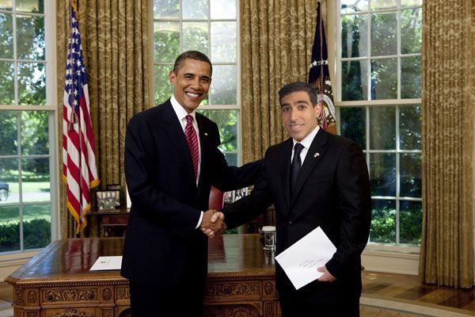
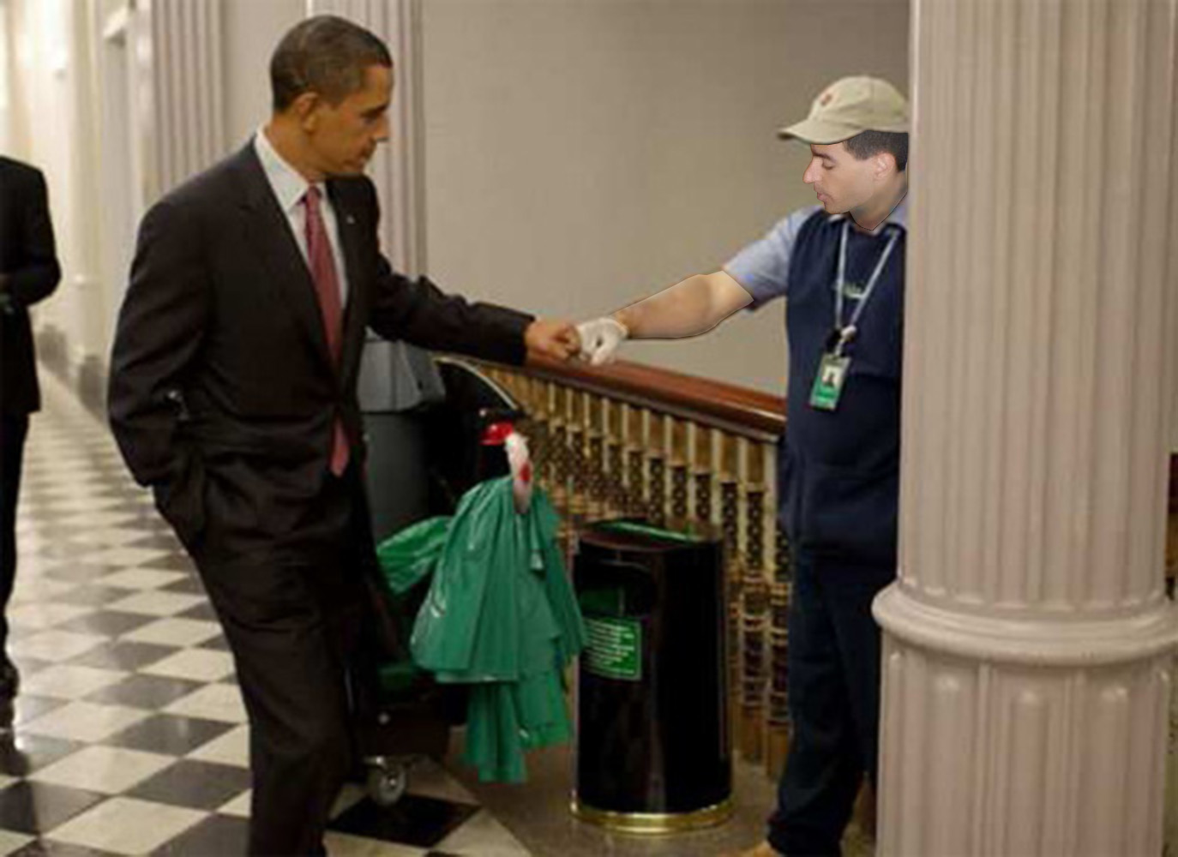
Monday, May 4, 2009

Slide 4
Wednesday, June 3, 2009

Slide 5
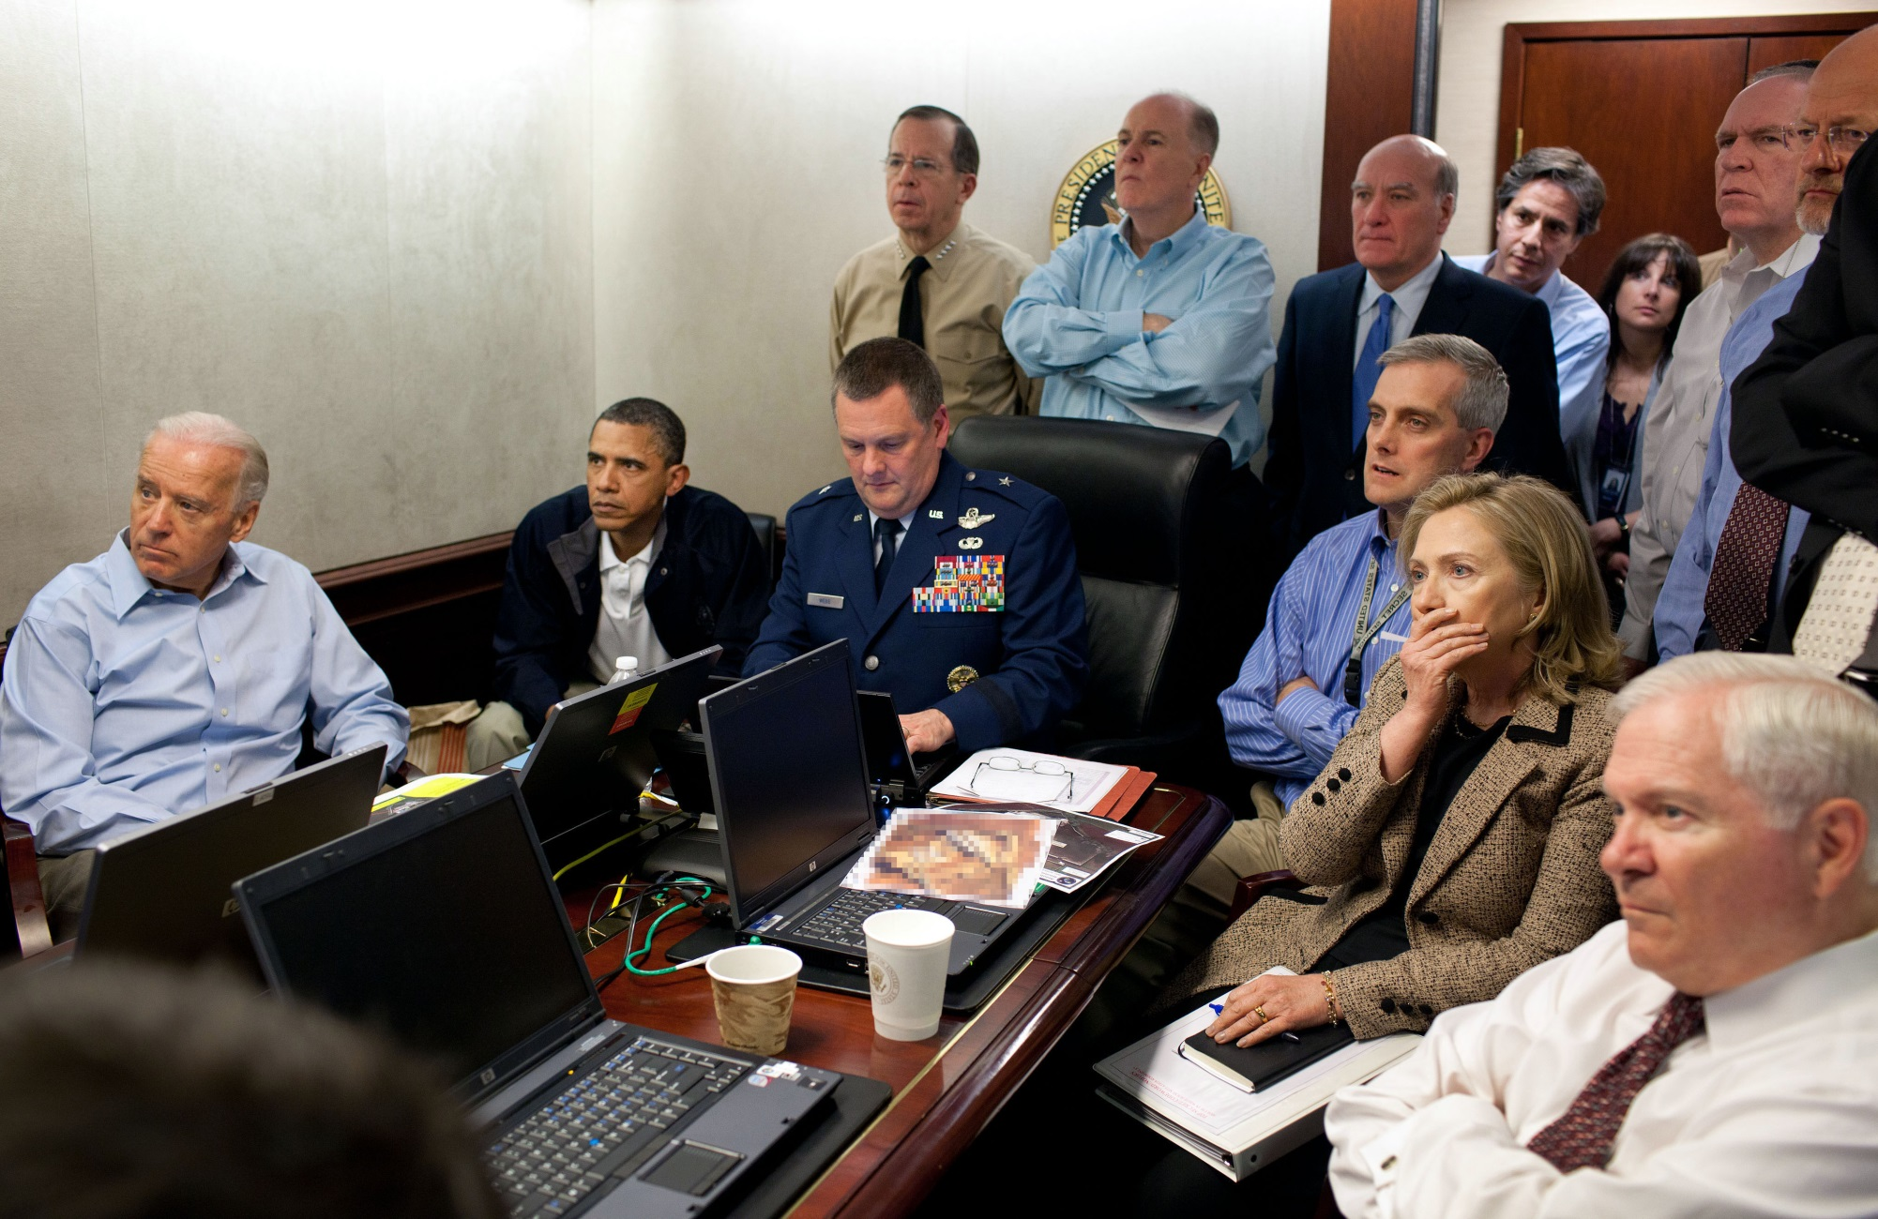
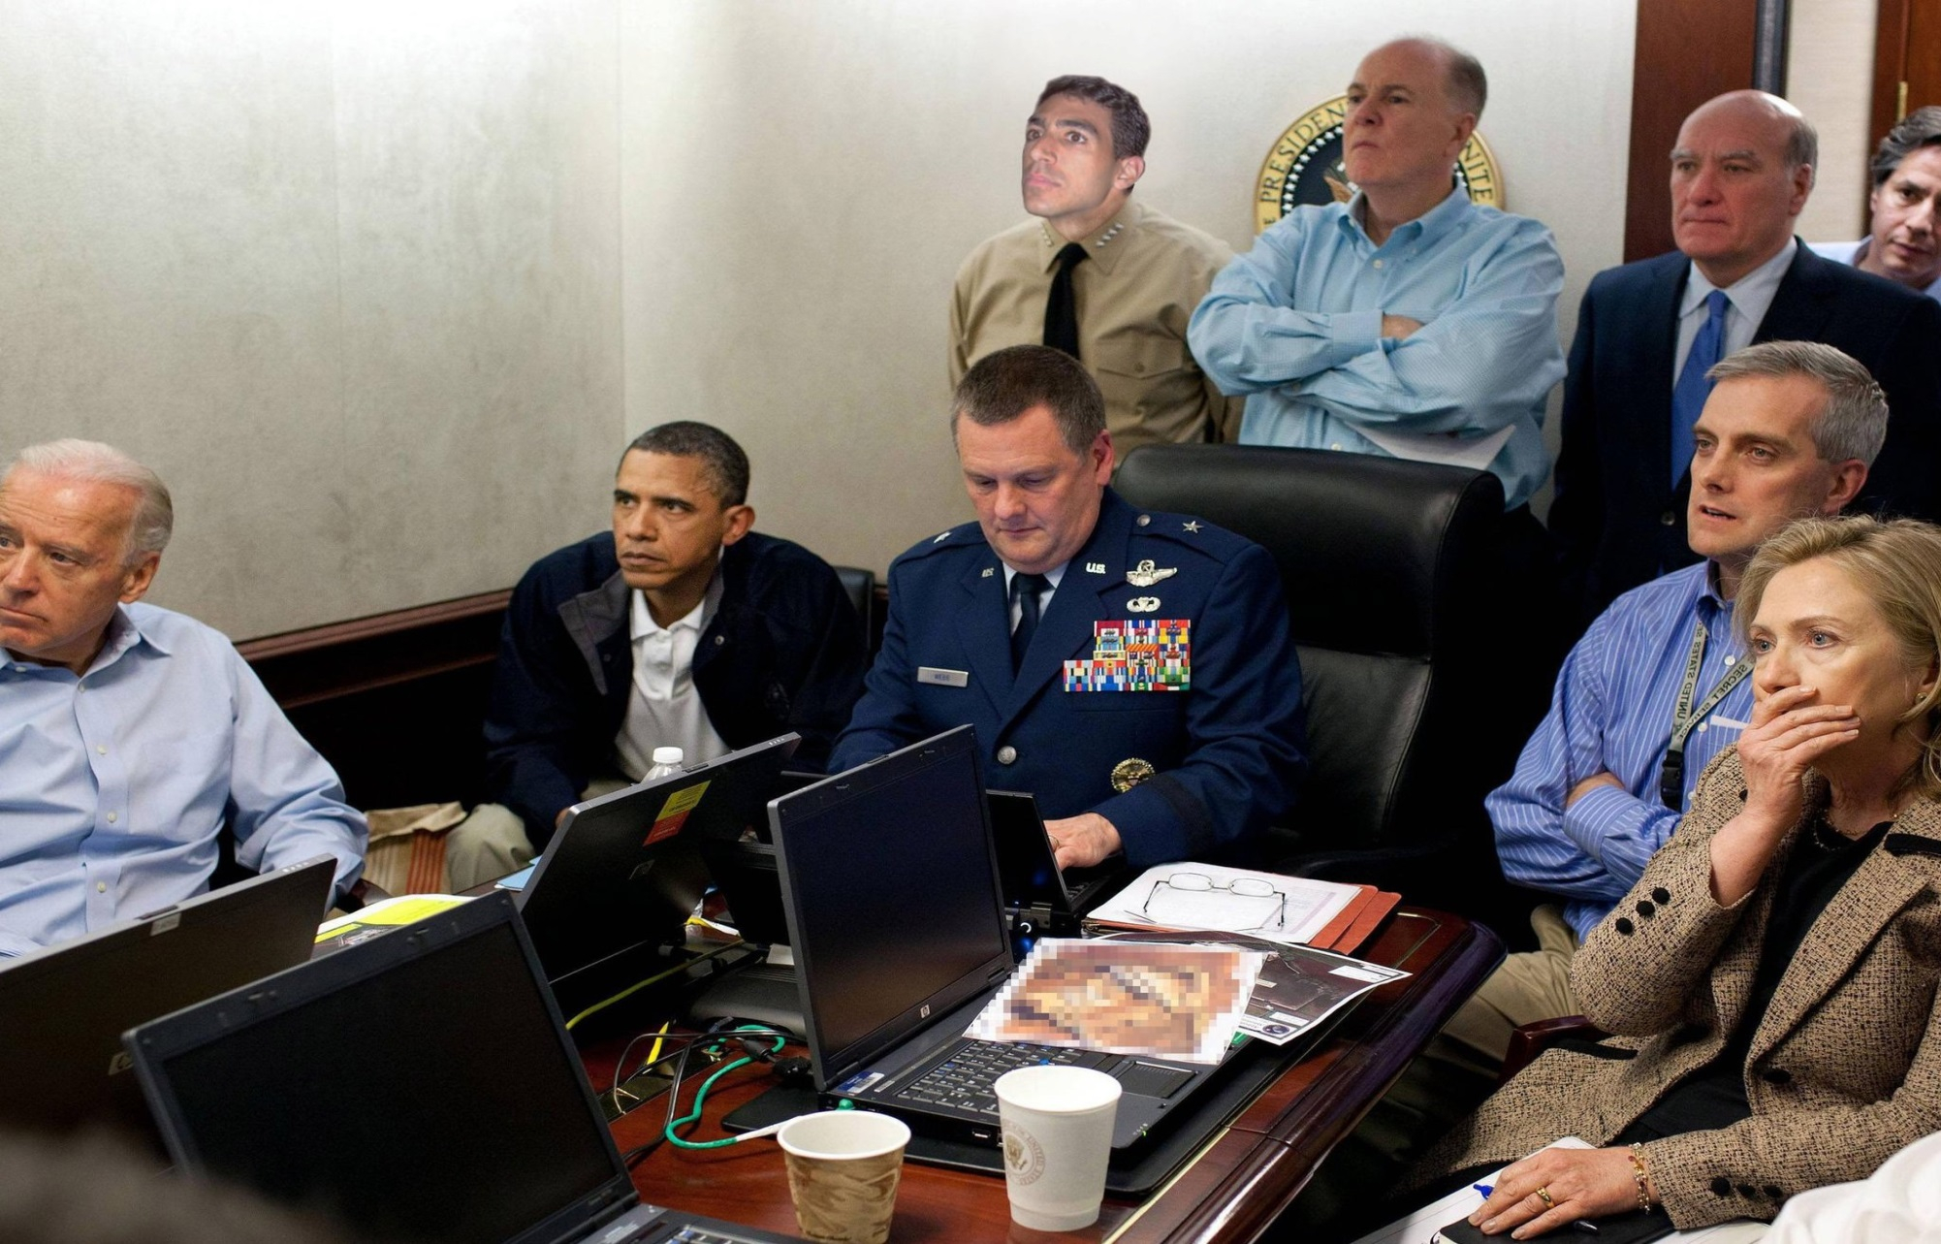
Monday, May 2, 2011

Slide 6
Monday, May 2, 2011

Slide 7

Monday, May 2, 2011

Slide 8
Thank You

